Slide 1
Sample Superstore Analysis
Submitted by:
Geoffrey Joseph Divino - 100842593
Aysegul Yalcinkaya – 100841003
July 14, 2022

Slide 2
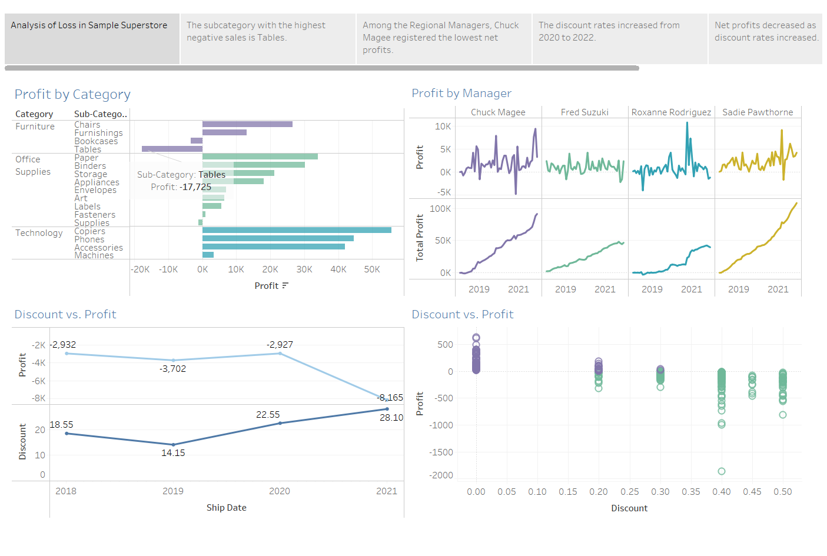

Slide 3
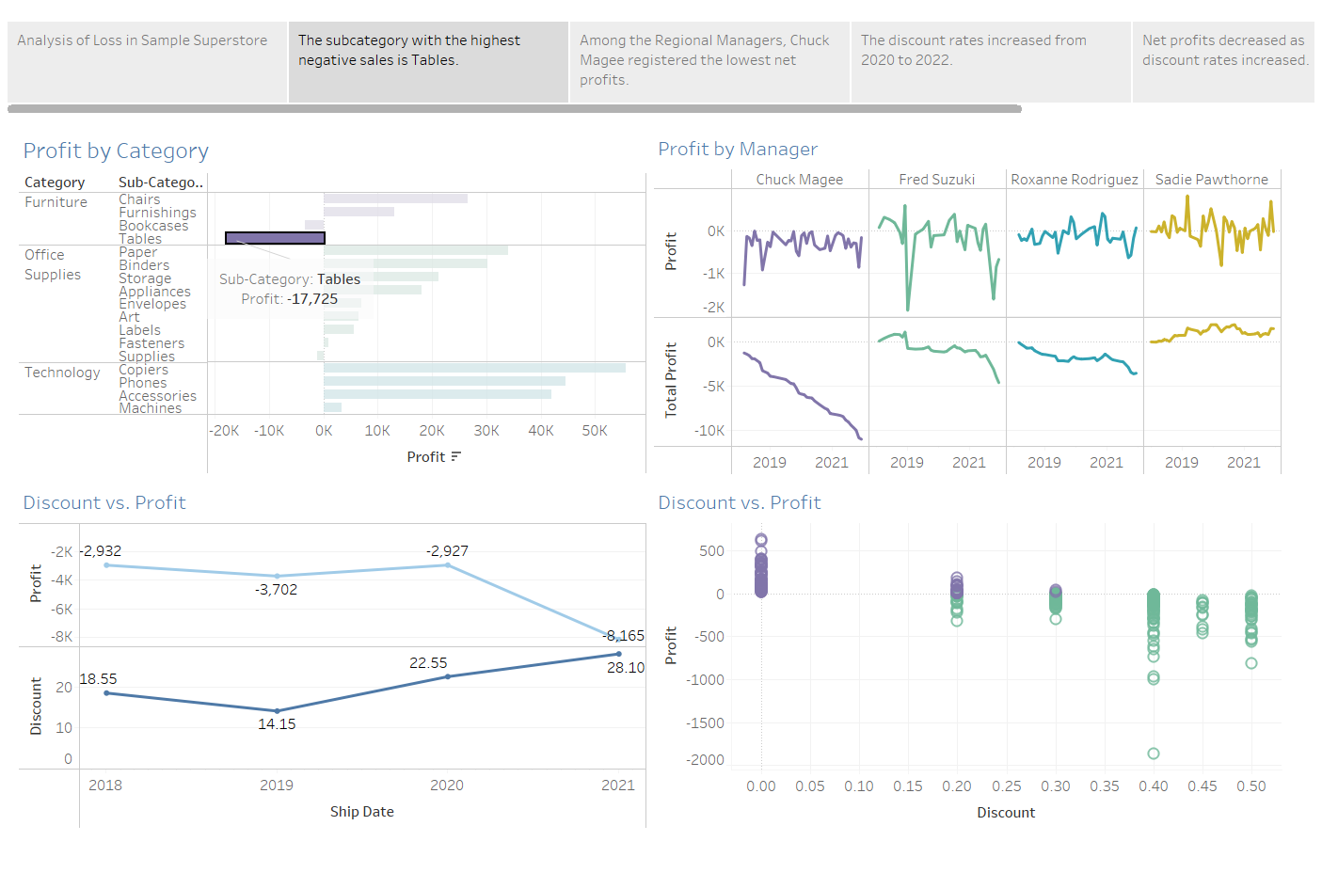

Slide 4
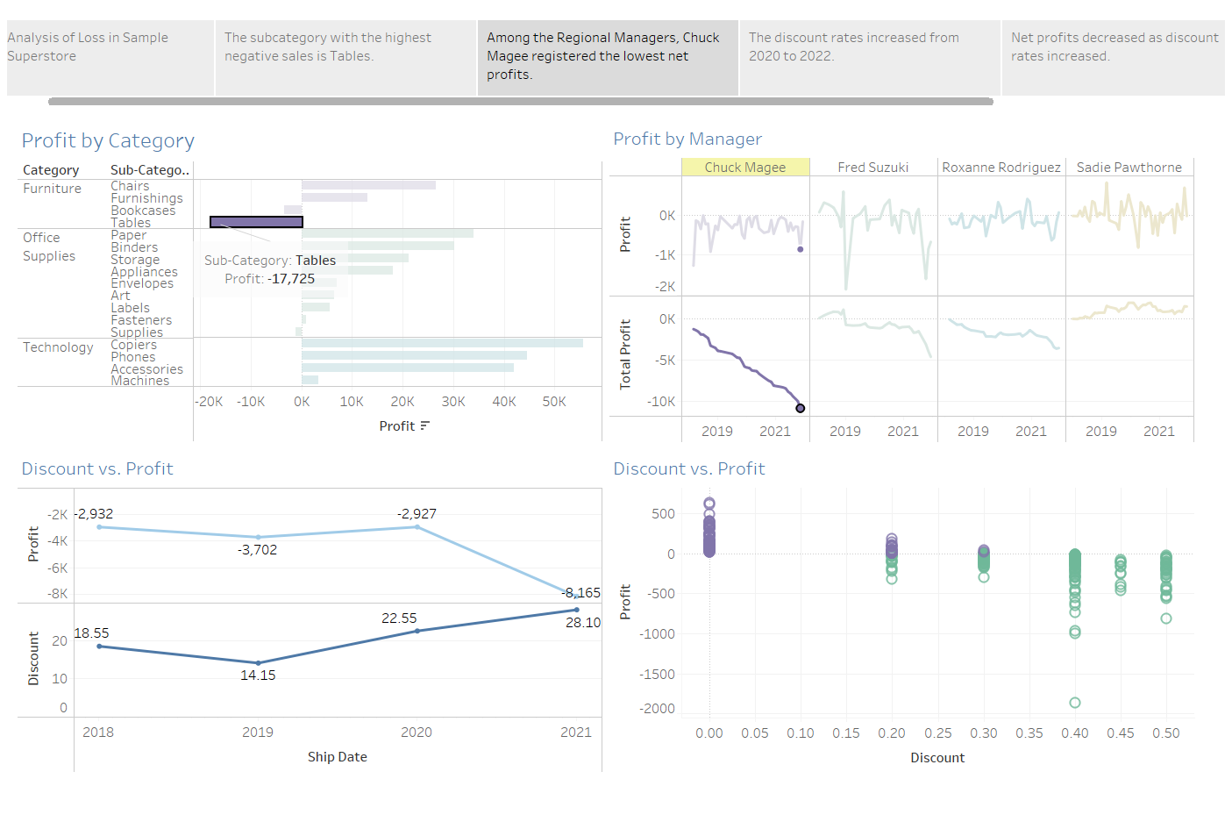

Slide 5
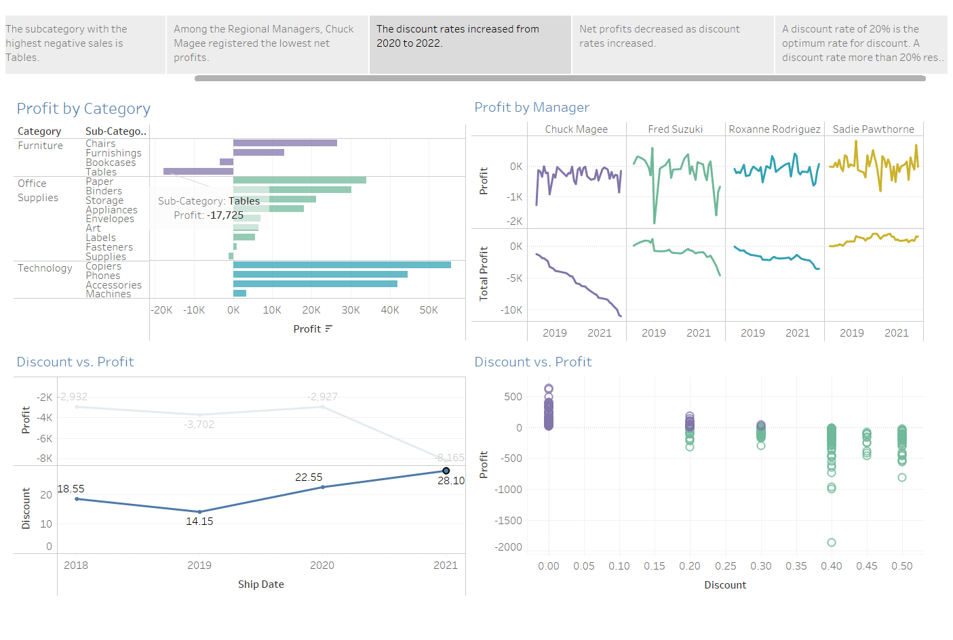

Slide 6
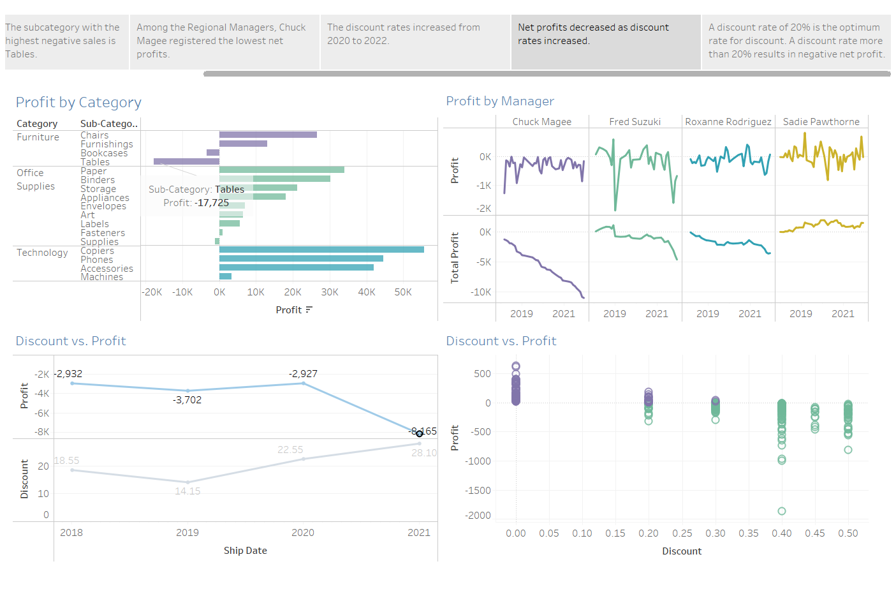

Slide 7
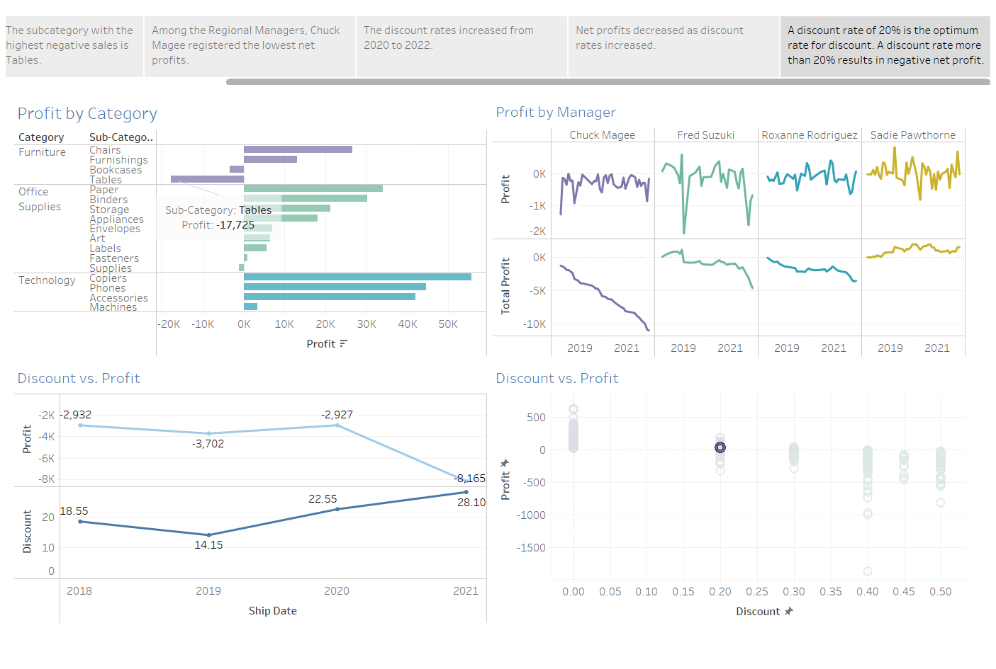

Slide 8
Log
Aysegul Yalcinkaya
Profit by Category
Profit by Manager
Dashboard design
Story design
Geoffrey Joseph Divino
Discount vs. Profit (Line chart)
Discount vs. Profit (Scatter plots)
Dashboard design
Story design

